Slide 1
Turtle
By Rachael Sera for Junior Knights

Slide 2
Turtle.py is Reserved
Do not name file “turtle.py”
Okay: turtlesquare.py turtletriangle.py turtlestuff.py

Slide 3
Basic Commands
penup()
pendown()
forward(distance)
left(degrees)
right(degrees)

Slide 4
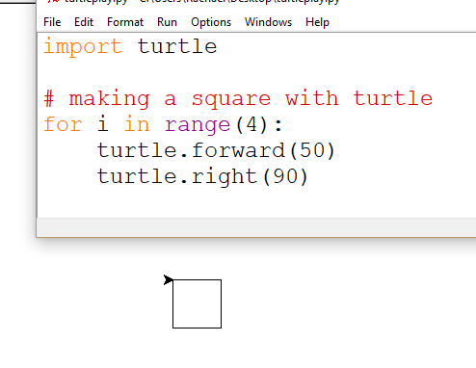
Square
Draws 4 lines 50 px long
With 90 degree angles between them

Slide 5
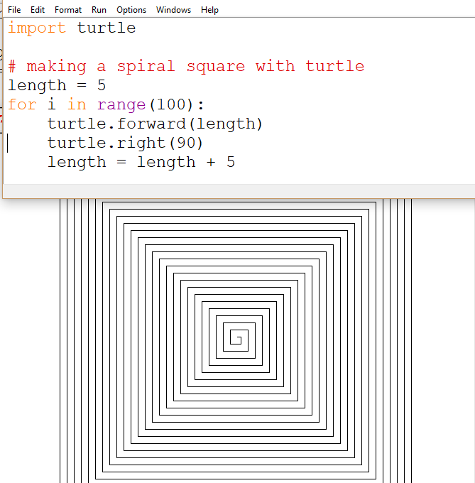
Spiral Square
Increase the length of the side each time

Slide 6
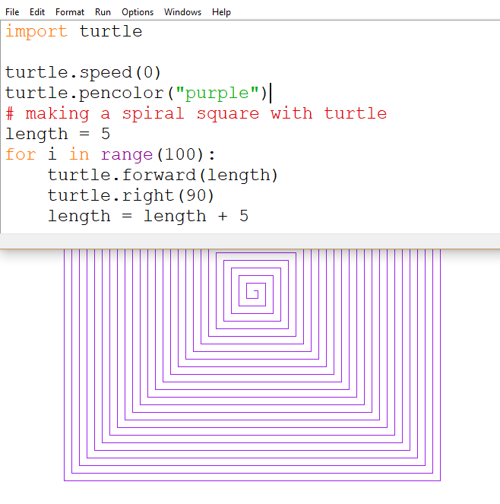
Speed and Color
Modify turtle.speed() to change how fast it creates the shapes
turtle.speed(0) is super fastest
Modify turtle.pencolor() to change the color its drawn in
pencolor() can take a color string or rgb values as an argument

Slide 7
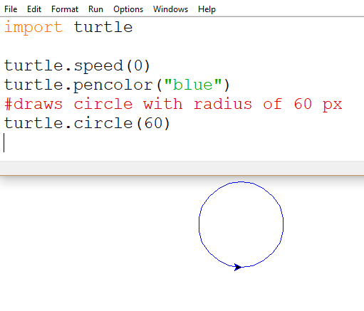
Circles
turtle.circle(radius) makes 1 circle with whatever radius you enter

Slide 8
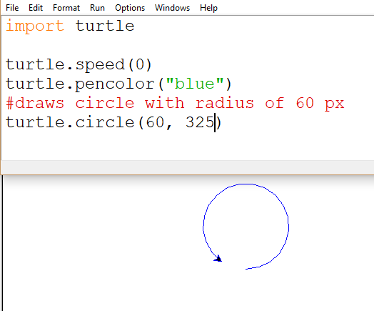
Circles
turtle.circle(radius, extent) draws a portion of a circle that is “extent” degrees long

Slide 9
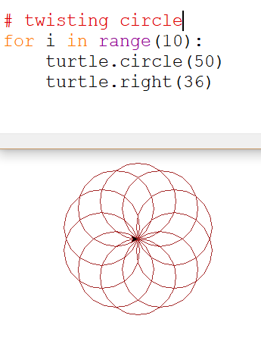
Fun with Turtle

Slide 10
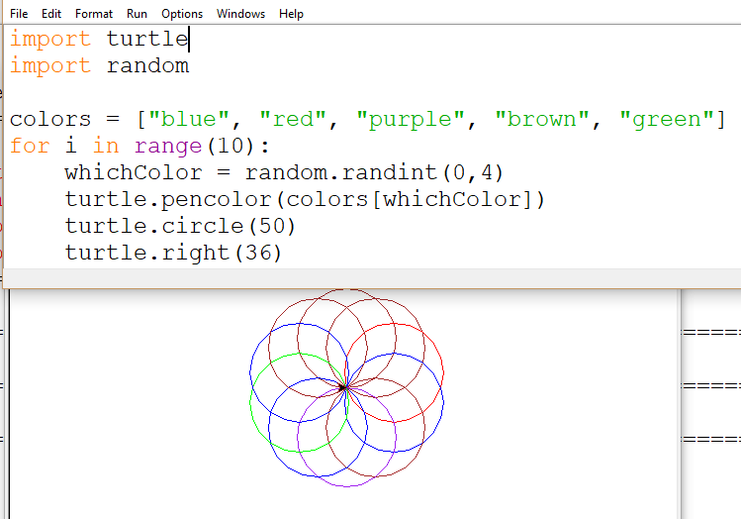
Pick a random color for each circle
Make a list of colors
Randomly select which color to make the pencolor

Slide 11
More Turtle Methods
https://docs.python.org/3/library/turtle.html
turtle.pensize(), turtle.pencolor()
turtle.position(), turtle.heading()

Slide 12
Practice Problems
goo.gl/nyNgGJ

